Slide 1


Slide 2
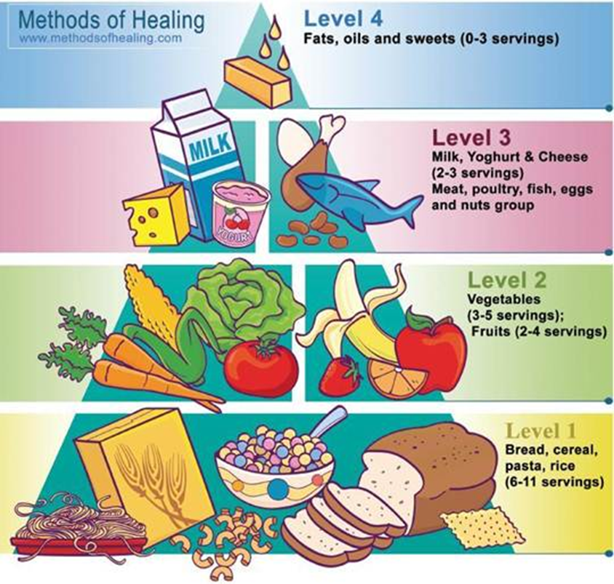
Balanced Diet

Slide 3
Carbohydrates are needed for energy.
Fruits & vegetables.
Protein helps your body grow and repair itself.
Fats provide energy plus insulation for the body.

