Slide 1
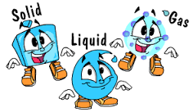
States of matter and heat movement

Slide 2
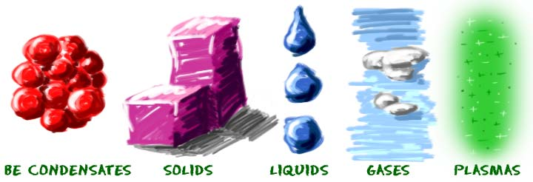
There are three states of matter:
  Solid
  Liquid
  Gas
  Who knows the difference?
  Let’s learn more about it!

Slide 3
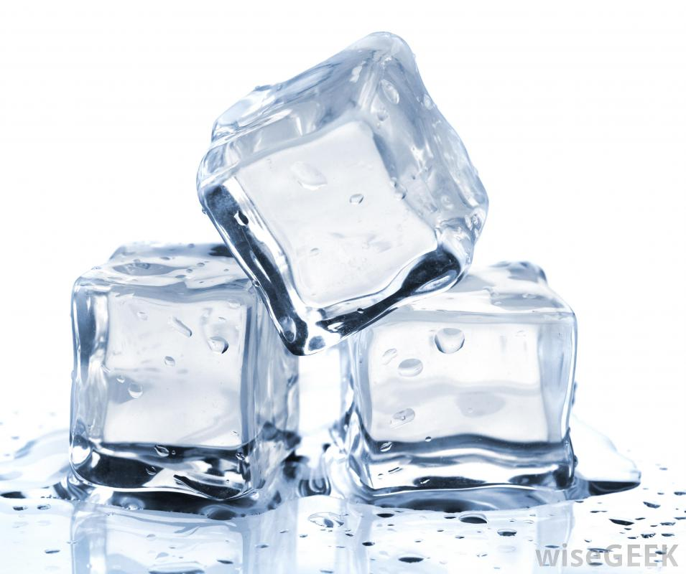
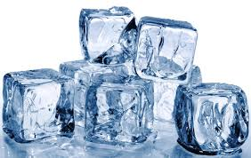
Solid: materials which hold its shape and take up space.

Slide 4
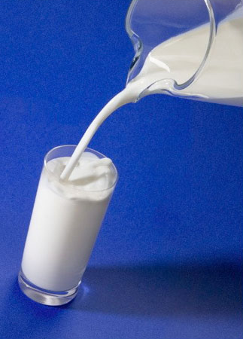

Liquid: materials which take up the shape of their container and can be poured.

Slide 5

Gases: materials which do not have a definite shape and no color.

Slide 6
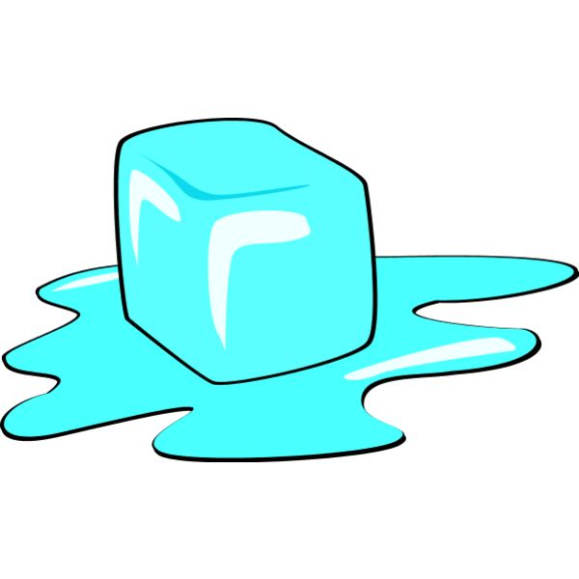
How can we move from one state of matter to another?
By HEAT

Slide 7
Heat movement is always from cold to hot.
For example: to MELT a solid to become liquid, it takes up heat from the surroundings.

Slide 8
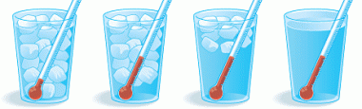
We will carry out a simple experiment to see how we can slow down the movement of heat.
in this experiment we have to use the thermometer, so let’s see how?

Slide 9
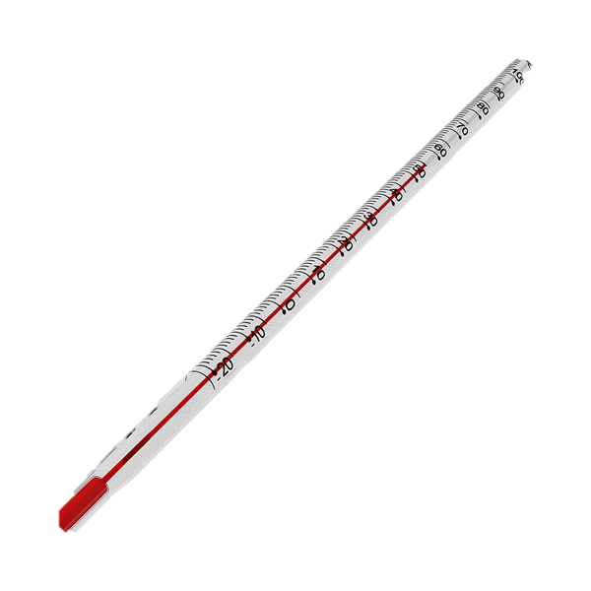
How to use the thermometer
Open the case and take it out
Put the red tip at the end of the rod in the cup through the hole.
Note the red marking as it increases, and write down the number which corresponds to the mark.

Slide 10
Instructions
Divide into 5 groups and have a group leader for each
We will put ice in 4 plastic cups
  the first cup is to be covered with fabric
  the second is to be covered with aluminium
  the third is to be covered with cling wrap
  the last is without any cover.
3. Thermometers are to be put in the cups.
  You will write the first temperature and the temperature after 5 minutes.

Slide 11
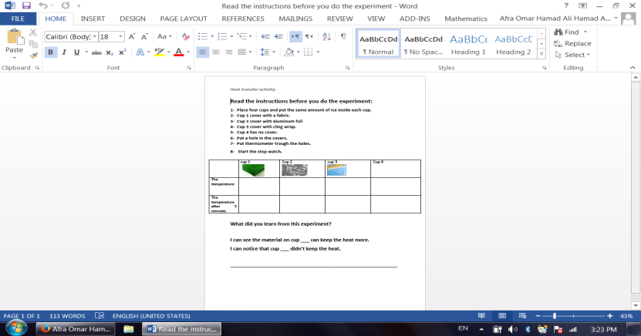
Movement of heat can be slowed by covering the cup. Also, heat is what melts solid ice to liquid water
1
4

Slide 12
☺

