Slide 1


Slide 2
Let's hear the song

Slide 3
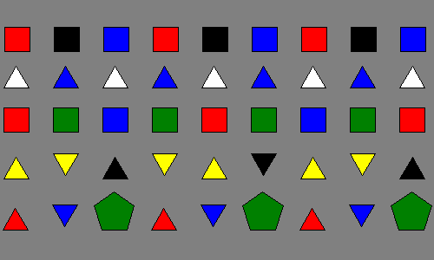
Let's review together

Slide 4
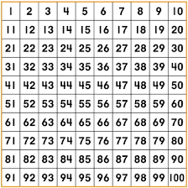
Chart numbers

Slide 5

Let's count by 5

Slide 6
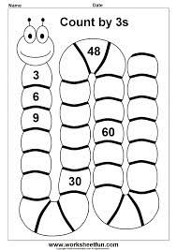
Activity 1

Slide 7
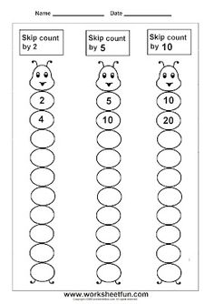
Activity 2

Slide 8
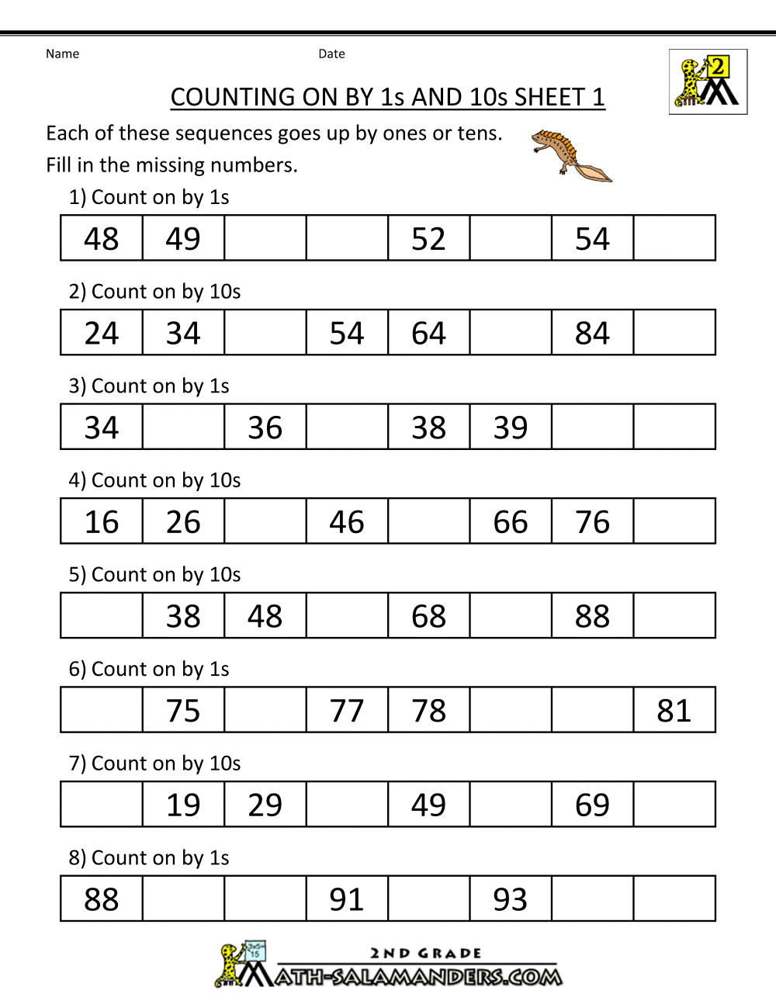
Activity 3

